Slide 1
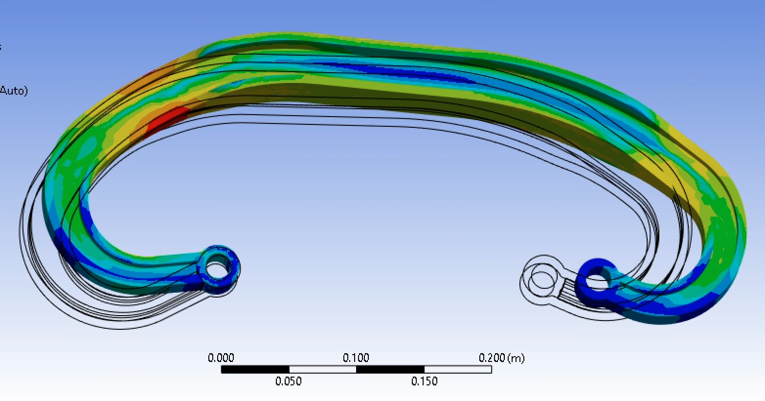
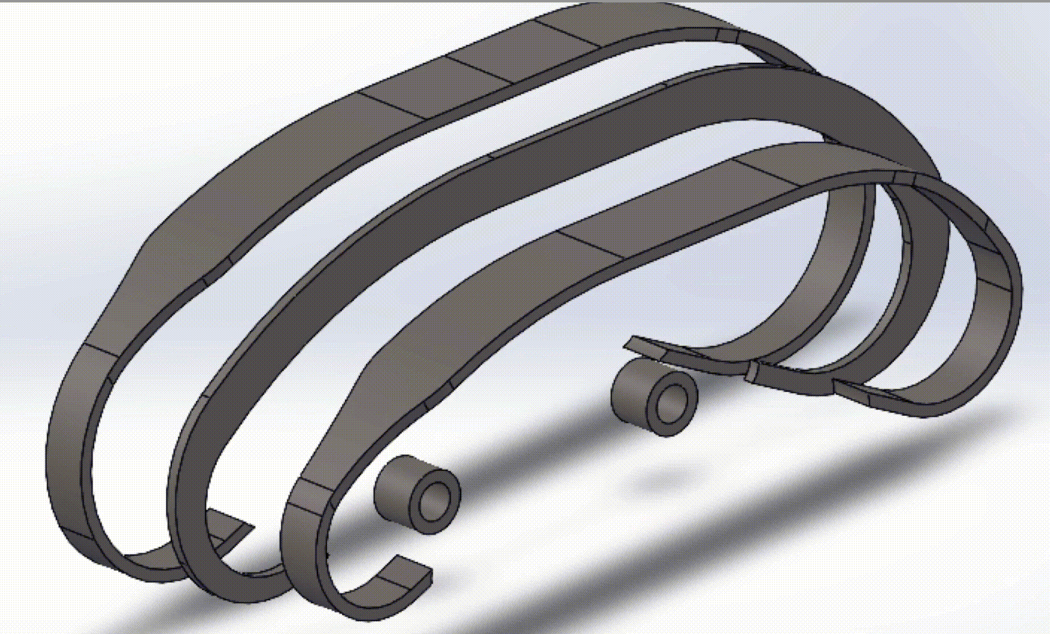


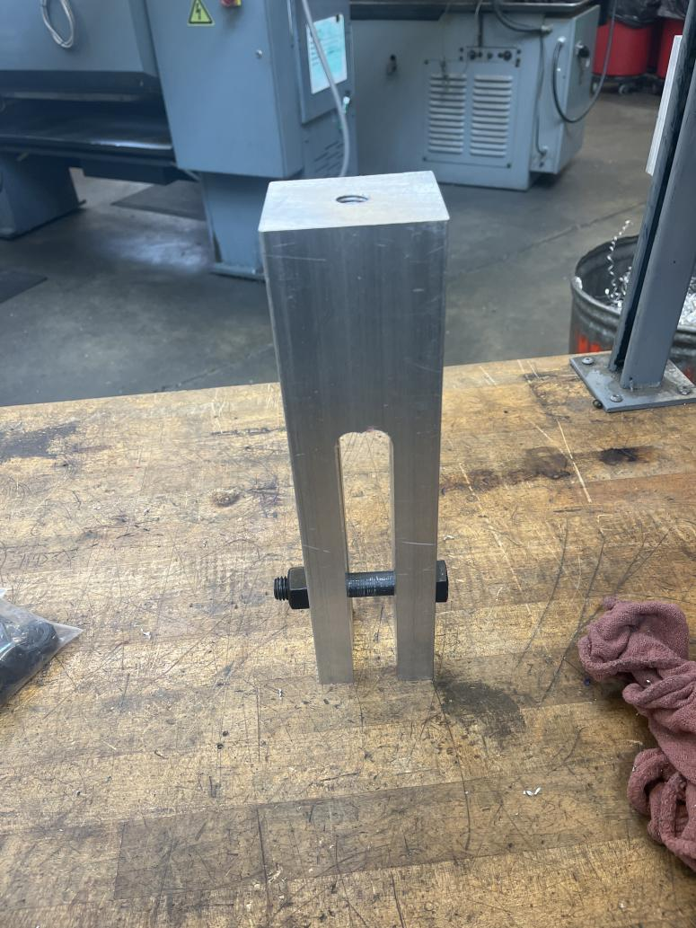
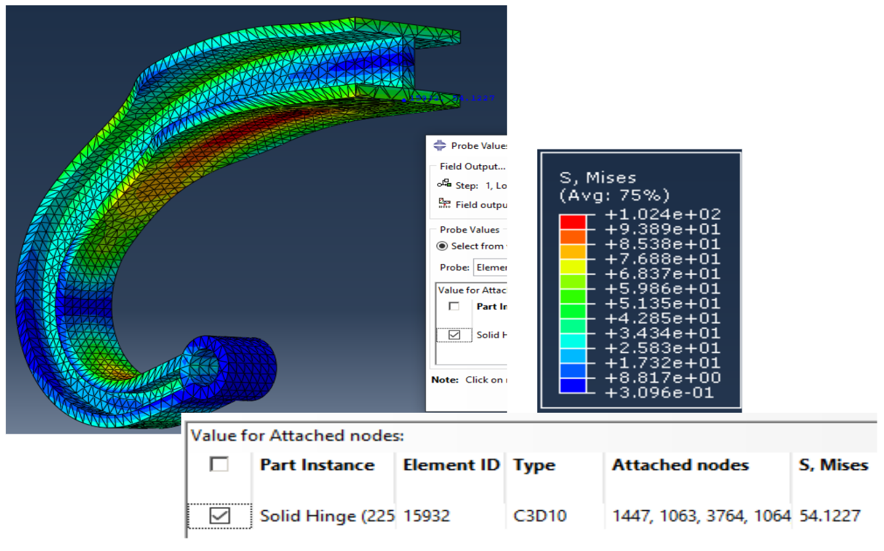
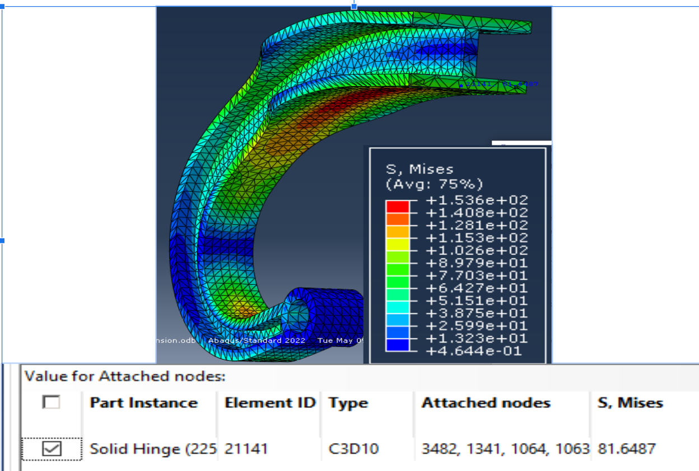
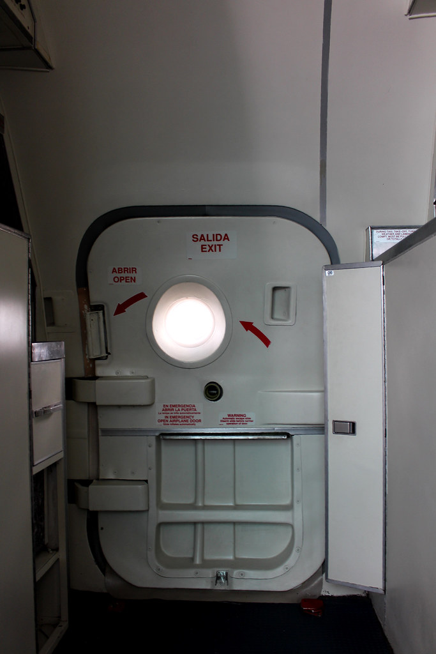
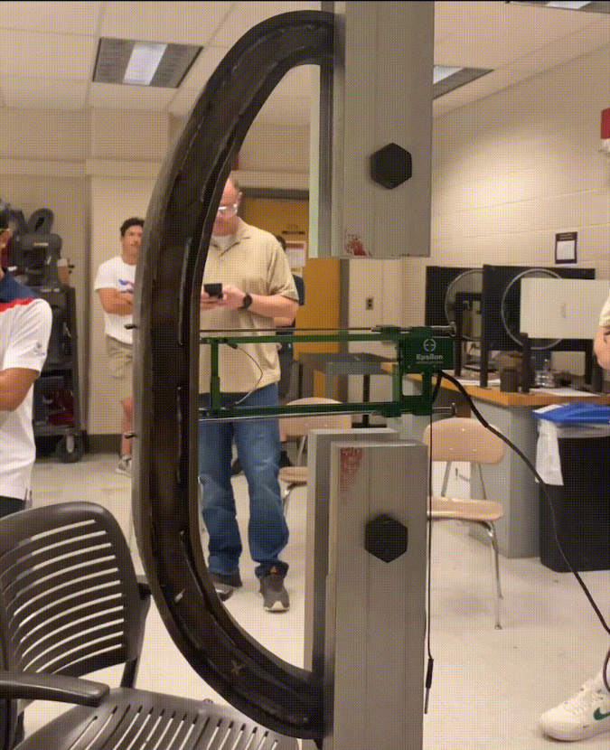
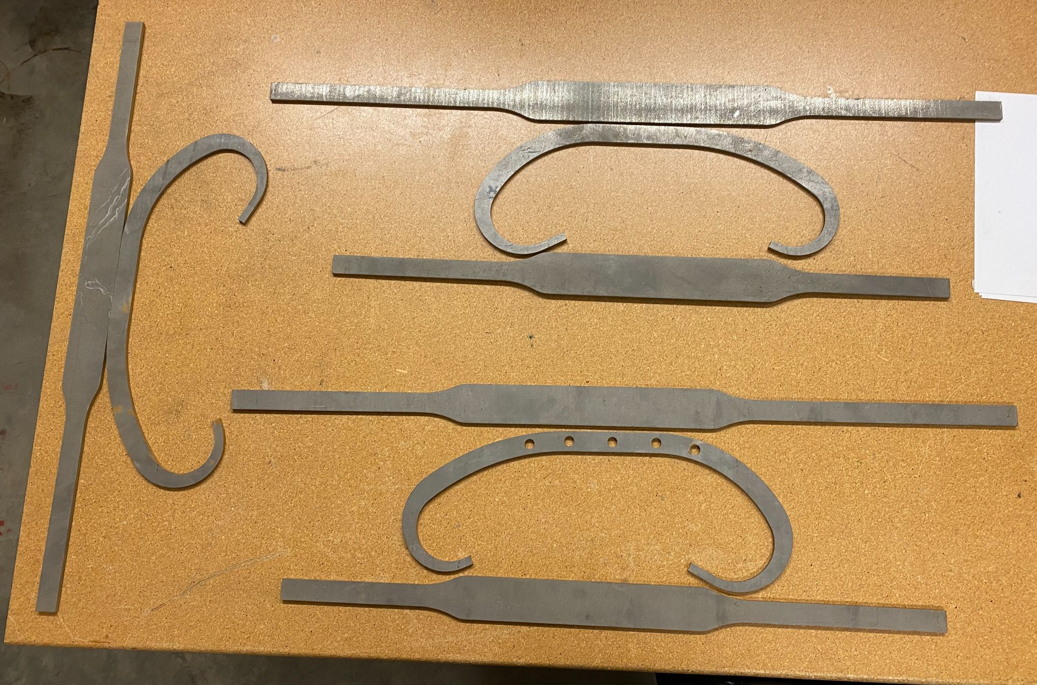
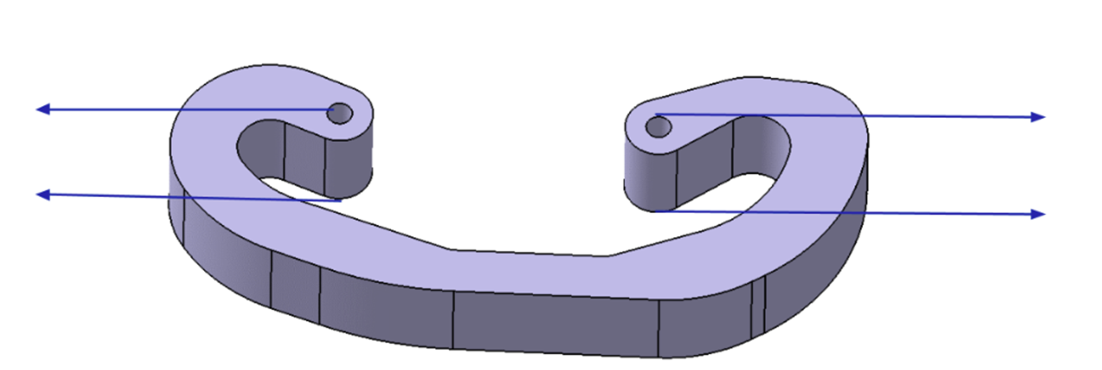
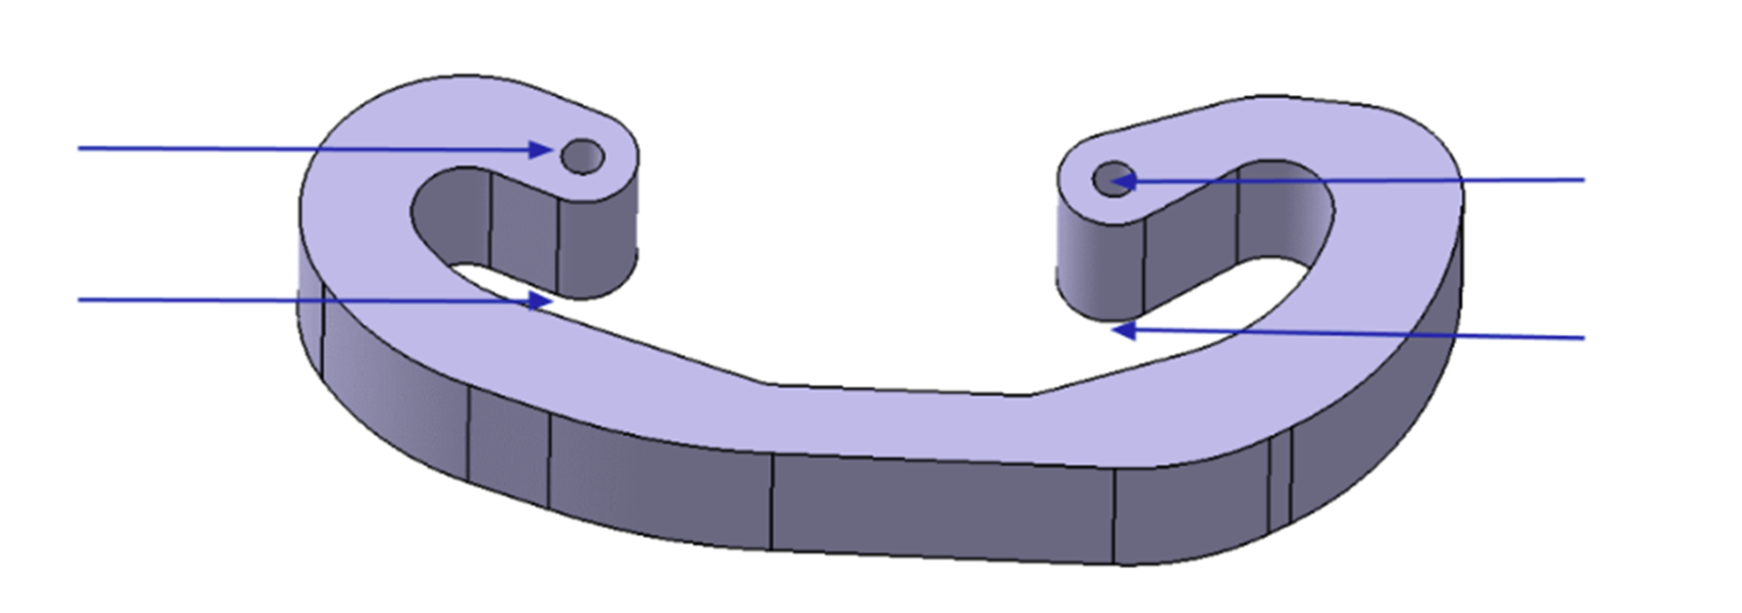

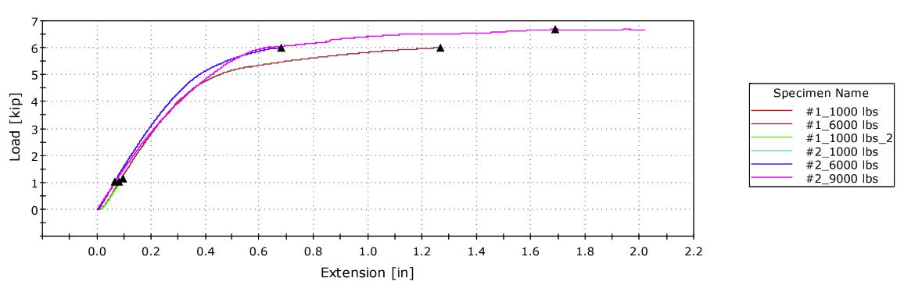
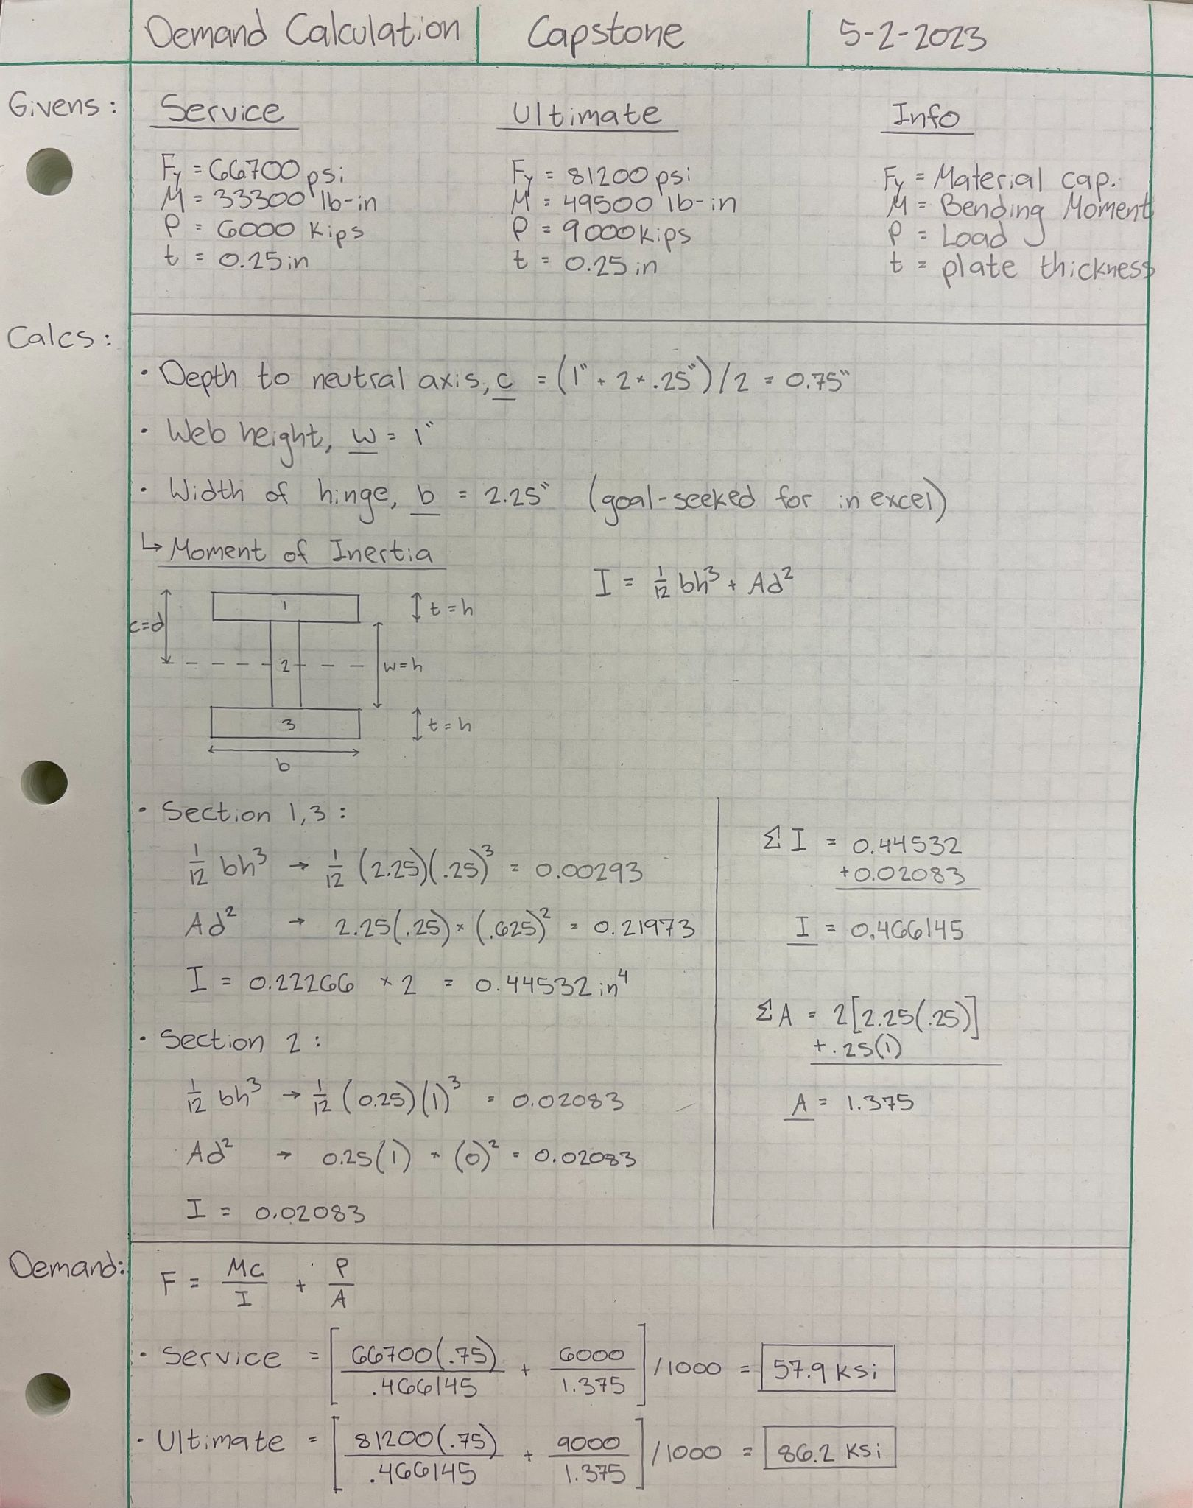
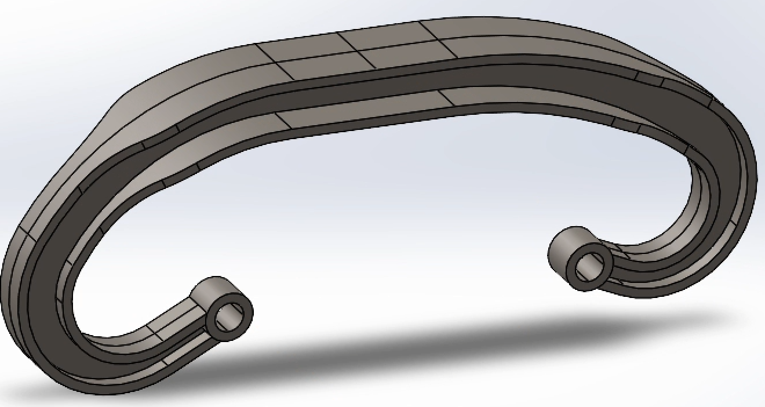
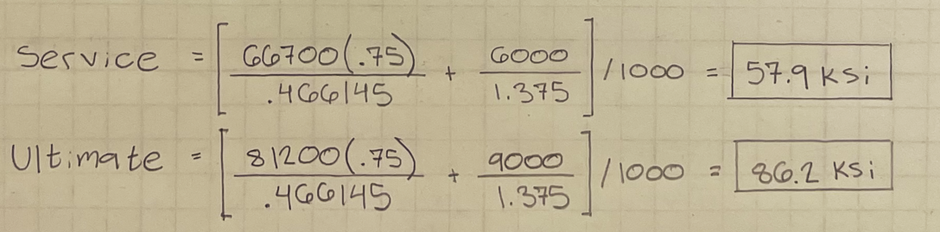
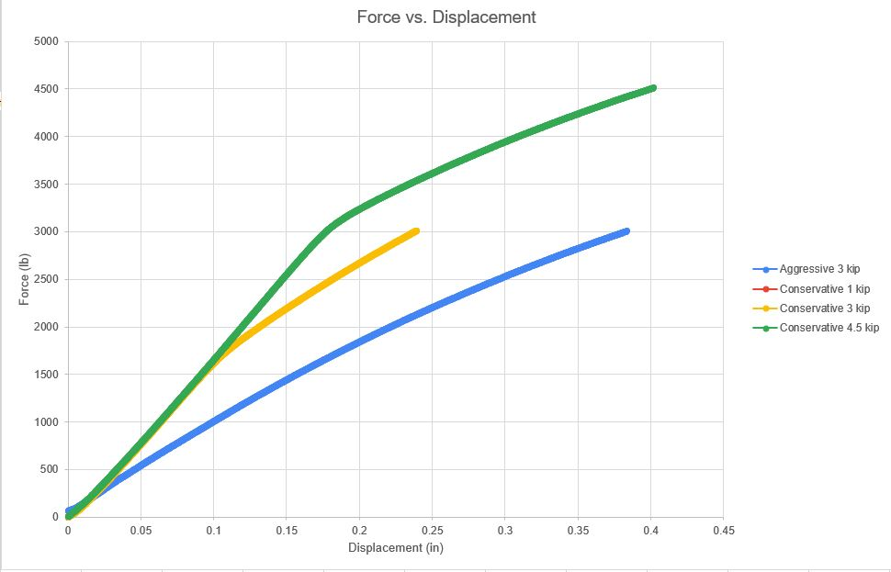
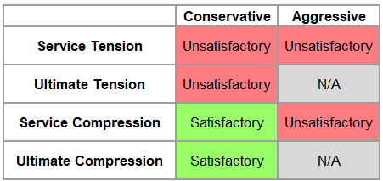
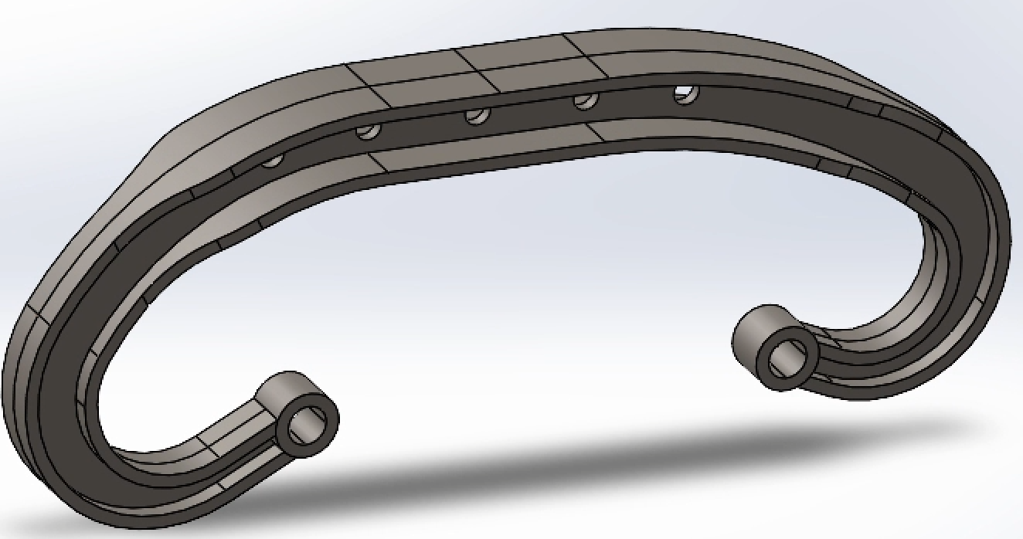

The Von ME-CEES
Nate Williams, Jacob Tobias, Jacob Derks, Wilson Wang, Matt Prado, Nikola Roso
Boeing Sponsored Capstone
CEE and ME Departments
Mechanical Engineering Capstone Exposition
June 2nd 2022, Husky Union Building, University of Washington, Seattle
Abaqus
Verify the stress tabulated in FEA with hand calcs and get deformation values between bolt holes
Manufacturing
INTRODUCTION
Manufacturing Process
  Cutting
  Annealing
  Welding
Cutting done at UW Mechanical Engineering Machine Shop
Annealing and welding done by Machinists Inc. (Seattle)
Custom testing fixture
Purpose:
To redesign and optimize a door hinge for a DC-9 aircraft
Constraints:
Allowable deflections under service loads
  Tension: 6000 lbs, 0.4 in
  Compression: 3000 lbs, 0.3 in
Failure past ultimate loads
  Tension: 9000 lbs
  Compression: 4500 lbs
Minimize weight
$4000 budget
Figure 9: Test Fixture
Figure 5: Final Design in Service Tension
Figure 6: Final Design in Ultimate Tension
Solidworks
Turning a concept into functional model to be tested with FEA
Utilizing features to help iterate design
2 Designs
Conservative
I-beam cross-section dimensions tabulated from hand calcs
Aggressive
  Thinner flange width
  Added holes in web
Intersection of design and manufacturing
Due to cost of materials and manufacturing processes, we focused our design around cutting out parts from a single plate of steel
​
Figure 10: Hinge in Instron Machine for Testing
Figure 11: Water-Jetted Pieces of the Hinges
Figure 1: Hinge Envelope in Tension
Figure 2: Hinge Envelope in Compression
CONCLUSION
Takeaways
  Earlier onset of yielding than expected
  Annealing, bending, and welding of our part may have introduced residual stress, stress concentrations, and heat-affected zones
  Unable to reach high loads due to the ductility of 4130 Steel
DESIGN AND DEVELOPMENT
Hand Calculations
Service loading: 57.9 ksi
Ultimate loading: 86.2 ksi
Graph 1: Tension Results
Figure 8: Aggressive Model
Table 1: Test Results
Figure 4: Results of Hand Calculations
Figure 7: Conservative Model
Figure 3: Calculations of Service and Ultimate Loading
Graph 2: Compression Results
Acknowledgements
Special thanks to our Boeing mentors Mitchell Mellor and Matt Soja, as well as Professor Richard Wiebe.
Notes:
The Mechanical Engineering front desk has provisions for printing posters. Make sure that you allocate sufficient time for printing.
A common poster size is 4 feet (length) * 3 feet (height)
You can move and rename the headings and sections included in the poster template as you wish. But your poster should highlight:
-- Introduction (Why are you doing this? What is the need? Use a well polished problem statement, take ample space to make this very clear!)
-- Core Functions (What’s new? What does your solution need to do to address the problem statement?)
-- Design (this should have a plan/layout of the work you set out to do and the key concepts and design decisions made. This should be the main focus of the poster)
-- Development (Describe the prototyping and fabrication of your project, or the analysis done)
-- Testing, and/or IP (work done or plans for future work, what is novel about your design?)
-- Conclusion (what did you achieve through your project?)
Please verify with any capstone sponsor that the poster does not contain confidential or proprietary information - you should give the sponsor plenty of time to review &/or provide input on poster content.
Keep text to a minimum (use bullets and lists). Make sure all text is large enough to be read from a distance of 2 meters, nothing smaller than 44 point font.
The listed bullet prompts are simply suggestions for inspiration, you don’t need to explicitly address each one. Determine what the main message is that you want to convey and then decide what information you need to provide to convey and support that.
Use images, graphs, and tables instead of text whenever possible.
Please submit only a PDF version of your poster. (You can create the poster in PowerPoint and go to the ‘save as’ option and save it as PDF. Please do NOT ‘print to PDF, as that may change the margins and other setting.
When creating the poster, please keep note of leaving sufficient print margins along the borders.
Please note that if you want us to print the poster for you, it needs to be submitted to the canvas assignment by 12:00 PM Friday 05/27/22.

